Slide 1

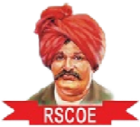
JSPM’s
Rajarshi Shahu College of Engineering, Tathawade, Pune
(An Autonomous Institute affiliated to Savitribai Phule Pune University)
Department of Computer Science and Business Systems
Academic Year: 2026-27
Project Title:Farmer to Consumer Local Marketplace
Students Name and PRN no:
Prathmesh Deshmukh (RBT25CB044)
Om Akolkar (RBT25CB046)
Date: October 2026
Course Name: Database Management System
Course Coordinator: Prof. Rutuja S. Bachhav

Slide 2
Index
Introduction
Problem Definition & Objectives
Literature Survey
Feasibility Study
System Design & Architecture
Database Design & ER Diagram
SQL Implementation & Results
Conclusion
References

Slide 3
Introduction / Background
Definition: A farmer to consumer local marketplace is a web application where farmers sell produce directly to nearby consumers, backed by a relational database.
Overview: Farmers list products priced per kg or gram, consumers order them, and an administrator manages users, orders, payments and deliveries.
Background: Farm produce usually passes through traders and commission agents, which reduces the farmer’s share and hides price and origin from the buyer.
Motivation: A direct digital channel gives farmers fair prices and consumers fresh local produce, and it needs consistent handling of stock, orders and payments, which is exactly what a DBMS provides.
Farmer
lists products and prices
Local Marketplace
Flask app + MySQL database
Consumer
orders and pays

Slide 4
Problem Definition & Objectives
Problem Definition
To design and build a database-backed application where farmers can add and remove products and set prices by unit (kg or gram), consumers can order them through a separate portal, and an administrator can supervise users, orders, payments and deliveries.
The database itself must keep stock, order totals and order status consistent.
Objectives
Design a relational schema from the ER diagram
Provide three portals: Farmer, Consumer, Administrator
Implement CRUD on products, users, orders, payments and deliveries
Use triggers for stock, totals and order status
Use cursors for sales and summary reports
Build a simple Flask and MySQL two-tier application

Slide 5
Literature Survey
Mandi and government platforms
Example: eNAM. Online trading of agricultural commodities between registered traders and mandis. Built for bulk trade, not for households.
Online grocery and agri-supply
Examples: BigBasket, DeHaat. They buy from farmers and sell to consumers or businesses. The platform sits between farmer and buyer and sets prices.
Informal local selling
Farmers’ markets, roadside sales, WhatsApp groups. Direct, but no stock tracking, order records or payment history.
Gaps identified
Small farmers have little control over price
Informal selling has no automatic stock update, so products can be over-sold
Orders, payments and deliveries are not kept in one consistent place

Slide 6
Feasibility Study
Technical Feasibility
MySQL, Python, Flask and plain HTML and CSS
Runs on an ordinary laptop
Skills used are covered in the course
Financial / Business
All tools are free and open source
No payment gateway fees in this version
Farmers keep the margin that middlemen take
Operational Feasibility
Simple forms for each of the three roles
Triggers keep stock and totals correct automatically
Administrator supervises orders and deliveries

Slide 7
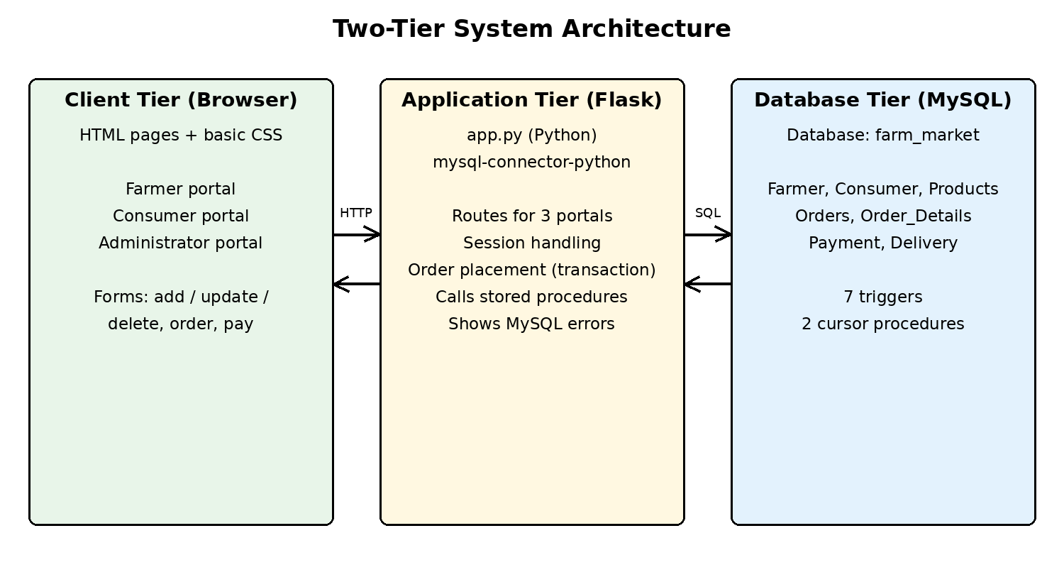
System Design & Architecture
Client tier: HTML pages and basic CSS for the three portals
Application tier: Flask app using MySQL Connector; handles sessions, orders and errors
Database tier: MySQL farm_market with constraints, triggers and cursor procedures
Roles: Farmer, Consumer, Administrator

Slide 8
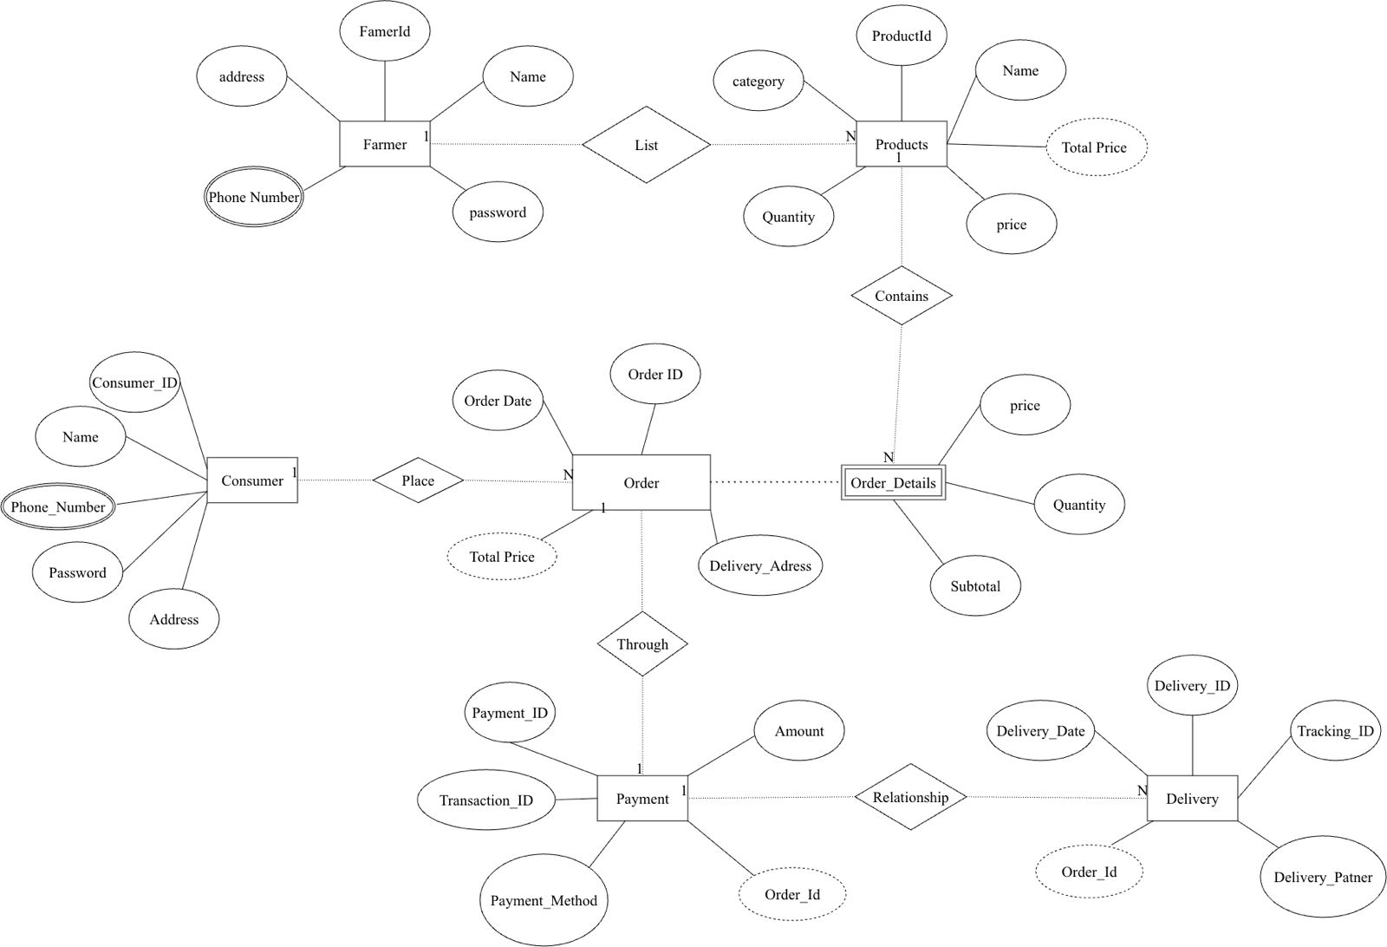
Database Design & ER Diagram
Farmer (1) lists Products (N)
Consumer (1) places Orders (N)
Order_Details is a weak entity, keyed by order_id and line_no
Products (1) appear in Order_Details (N)
Order (1) is paid through Payment (1)
Payment (1) relates to Delivery (N)
Phone numbers are multivalued, so they use separate tables
total_price is a derived attribute

Slide 9
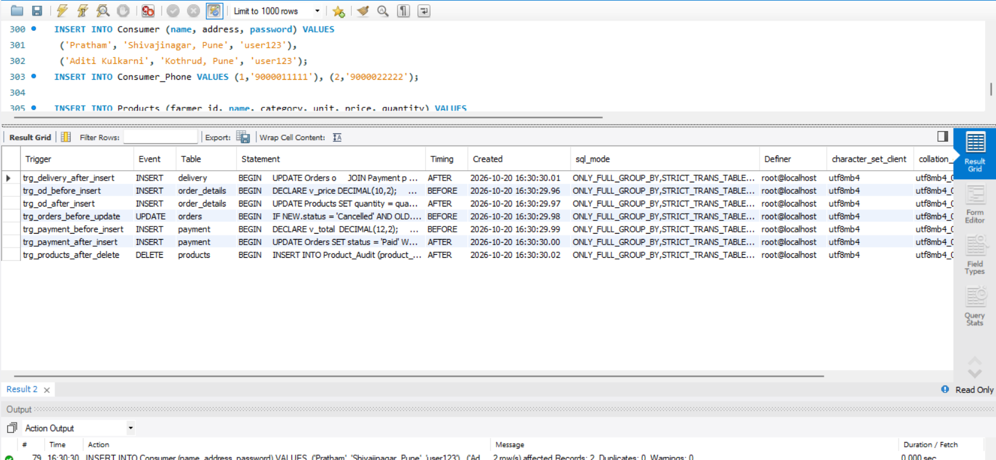
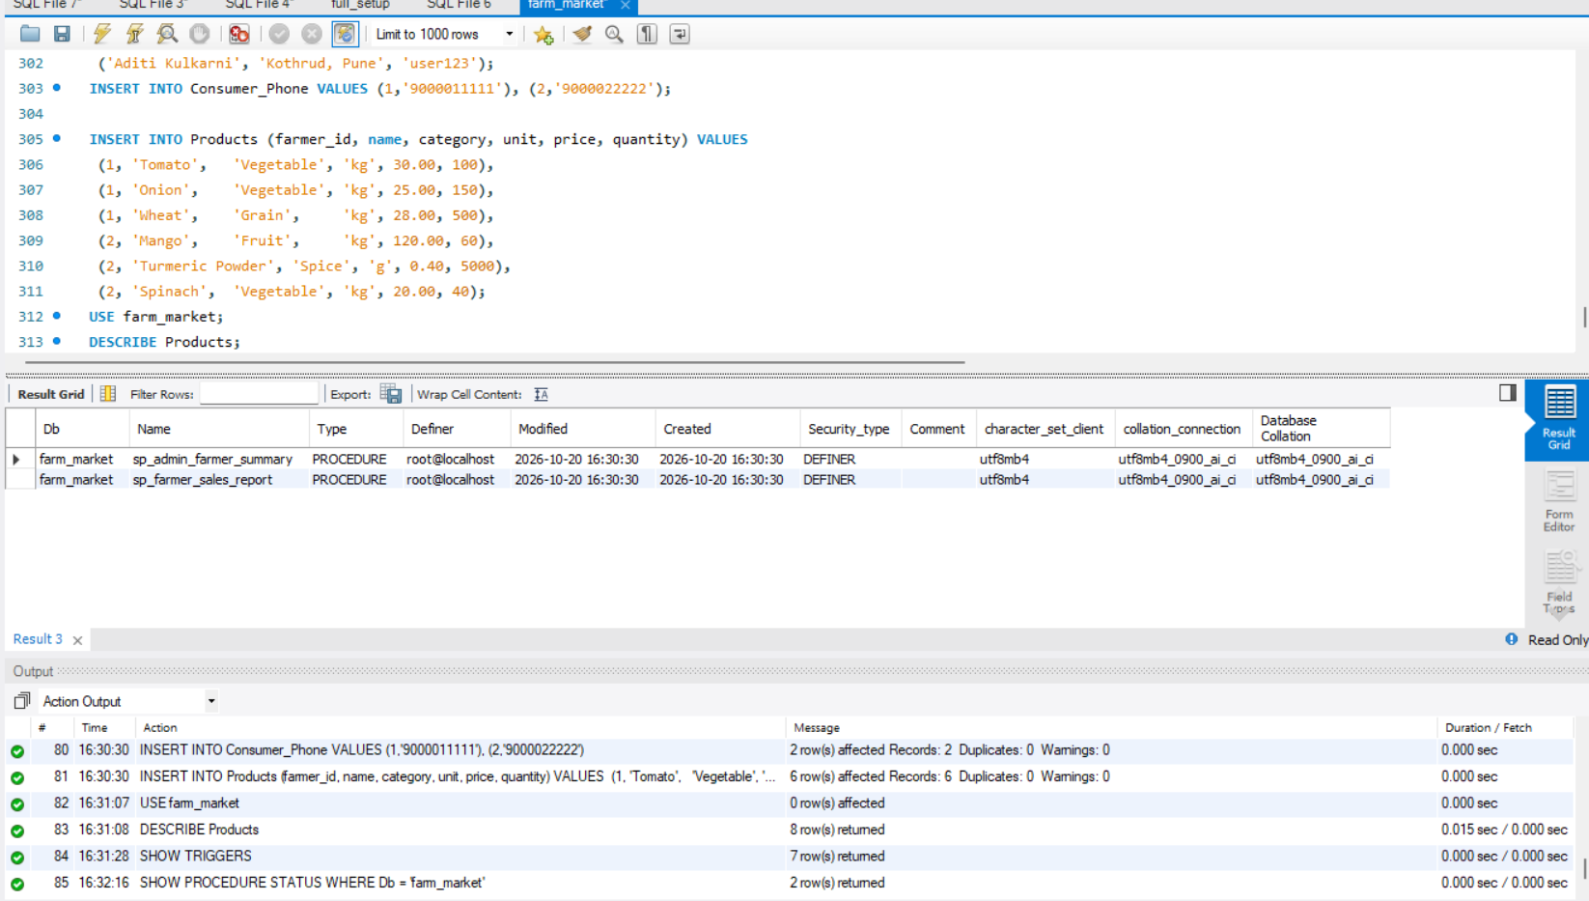
SQL Implementation & Results
10 tables with primary and foreign keys, CHECK constraints and a generated total_price column
CRUD: products, farmer and consumer registration, orders, payments and deliveries
7 triggers: stock check, stock update, order total, cancel and restore stock, payment check, payment status, shipping status, product delete log
2 cursor procedures: sp_farmer_sales_report and sp_admin_farmer_summary
Orders run as one transaction; any trigger error rolls everything back

Slide 10
Application Screenshots
Screenshot placeholder
Farmer portal: product list and sales report
Screenshot placeholder
Consumer portal: products and order form
Screenshot placeholder
Administrator portal: overview and orders
Screenshot placeholder
My Orders page: payment and cancel
Screenshot placeholder
Admin delivery form or trigger result

Slide 11
Conclusion
What was achieved
Working three-portal marketplace on one database
Farmers set prices per kg or gram and manage stock
Stock, totals and order status update automatically through triggers
Sales report and admin summary use cursors
Limitations and future scope
Hash passwords instead of plain text
Add a real payment gateway
Add product photos, ratings and location search
Add notifications and live delivery tracking

Slide 12
References
[1] R. Elmasri and S. B. Navathe, Fundamentals of Database Systems, Pearson.
[2] A. Silberschatz, H. F. Korth and S. Sudarshan, Database System Concepts, McGraw-Hill.
[3] Oracle Corporation, MySQL 8.0 Reference Manual, https://dev.mysql.com/doc/
[4] Oracle Corporation, MySQL Connector/Python Developer Guide, https://dev.mysql.com/doc/connector-python/en/
[5] Pallets Projects, Flask Documentation, https://flask.palletsprojects.com/
[6] National Agriculture Market (eNAM), Government of India, https://enam.gov.in/

